Slide 1
Posis Technology
Optics in Surface Inspection
www.posishome.co.kr
www.posistechnology.com

Slide 2
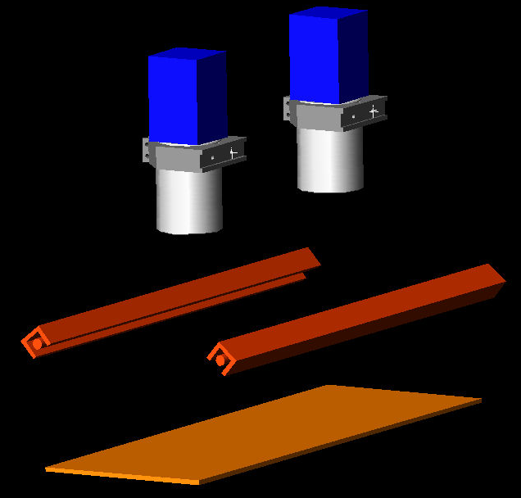
1. Inspection System

Slide 3
2. Camera
# Benefits of Line Scan Camera
Low – cost
High Dynamic Range
High Sensitivity
Fast Scanning without expensive strobing
# Consideration Point Before Choosing the Camera
1. 제품의 특성 – 투과, 반사 조명
2. 제품과 defect의 투과 or 반사 스펙트럼 성향.
3. Defect의 종류
4. 검출 사이즈에 대한 한계 → FOV와 관계
5. 제품의 이송속도

Slide 4
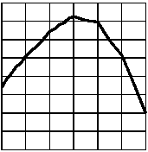
2. Camera
# Specifications of Line Scan Camera(Example : Dalsa Spyder SP-14)
# of pixels | 2048 | Data Format | 8-bit LVDS
Pixel Size | 14 ㎛ X 14 ㎛ | Response | 12-96DN(nJ/cm2)
Aperture Size | 28.7 mm X 14 ㎛ | Dynamic Range | Up to 830:1
Lens Mount | F-mount | Gain Range | 1-8x
Max. Line Rate | 18.7 kHz | Operating Temp. | 0-50 ℃
Data Rate | 40 MHz | Power Dissipation | <6W
SP-14 Responsivity(8x gain)
Responsivity [DN(nJ/cm2)]
Wavelength(nm)

Slide 5
Calculation of Working Distance ; Single Lens
Optics in Surface Inspection
2. Camera
# Type
Line Scan Camera (Digital, Analog)
# Resolution of Camera
Spatial Resolution : 1, 2, 5 k (1024, 2048, 5120 pixels) <= Camera Scan Direction
Temporal Resolution : 10, 20, 30, 40 MHz <= Sample Progress Direction
ex) Dalsa Line Scan Camera(2 k, 40 M) : 2048 pixels, 40 MHz(18.7 kHz/line)
Sample Progress Direction
Spatial Resolution
Camera Scan Direction
Temporal Resolution

Slide 6
Calculation of Working Distance ; Single Lens
Optics in Surface Inspection
2. Camera
Sensor
Lens
Working
Distance
Resolution
Field of View(FOV)

Slide 7
Optics in Surface Inspection
Calculation of Working Distance ; Single Lens
y
o
x
x
o
i
f
f
y
i
S
S
o
y
i
y
: Object Size
i
: Image Size
o
S
: Distance between Object and Lens
S
: Distance between Image and Lens
o
i
S
=
x
+
f
S
=
x
+
f
o
o
i
i
y
x
i
S
f
M
=
=
i
=
i
=
T
y
S
f
x
o
o
o
y
x
y
f
i
i
i
=
y
=
f
,
y
x
o
o
o

Slide 8
Optics in Surface Inspection
Calculation of Working Distance ; Single Lens
y
o
x
x
o
i
f
f
y
i
S
S
Example
o
i
y
: Camera Aperture Size(dalsa) ; 28.7 mm
o
y
f : focal length of Lens ; 50 mm
i
: FOV(Field of View) ; 480 mm
y
x
x
x
i
i
480
i
= 836.23
=
=
i
y
f
S
x
= 886.23
o
28.7
50
i
=
i
+
f
y
f
x
i
480
50
= 2.989
=
o
y
x
=
o
o
28.7
x
S
=
x
+
f
= 52.989
o
o
o

Slide 9
Optics in Surface Inspection
Calculation of Resolution
1. Spatial Resolution
# Example
Dalsa Line Scan Camera (2 k, 40 M (18.7 kHz))
Aperture size = 28.7 mm
If FOV(Field of View) is 480 mm,
Size of each 1 pixel in FOV is 0.234 mm.
Size of 1 pixel = FOV / # pixels
= 480 mm / 2048 pixels
= 0.234 mm / pixel
FOV
Camera
28.7 mm
480 mm
2048 pixels
2048 pixels

Slide 10
Optics in Surface Inspection
Calculation of Resolution
2. Temporal Resolution
# Example (Dalsa Line Scan Camera, 2 k, 40 M (18.7 kHz))
Speed of Sample Progress = v (m/s)
Time of 1 line progress = 1 / 18.7 (sec)
Distance of 1 line progress in 1 clock
x = v t
➔ x = v * 1 / 18.7

Slide 11
Optics in Surface Inspection
Calculation of Resolution
3. Example of Resolution Calculation
# Example (Dalsa Line Scan Camera, 2 k, 40 M (18.7 kHz)), FOV = 480 mm
Speed of Sample Progress = 600 (m/min)
Spatial Resolution
= FOV / # of pixels = 480 (mm) / 2048 (pixels) = 0.234 mm/ pixel
Temporal Resolution
Speed of Sample Progress = 600 (m/min) = 10 (m/s) = 10000 (mm/s)
Time of 1 line progress = 1 / 18700 (sec)
Distance of 1 line progress in 1 clock
x = v t
➔ x = 10000 * 1 / 18700 = 0.535 mm
→ Resolution of this Sample = 0.234 X 0.535 mm

Slide 12
Optics in Surface Inspection
3. Light Source
Light Source : Red, IR, Blue, White, Green LED
Halogen Lamp, Laser, etc..
Optical Filter(polarizer, diffuser, beam
splitter, color filter, optical fiber, etc..)
+
Light Source = Light Source Systems
+
Controller

Slide 13
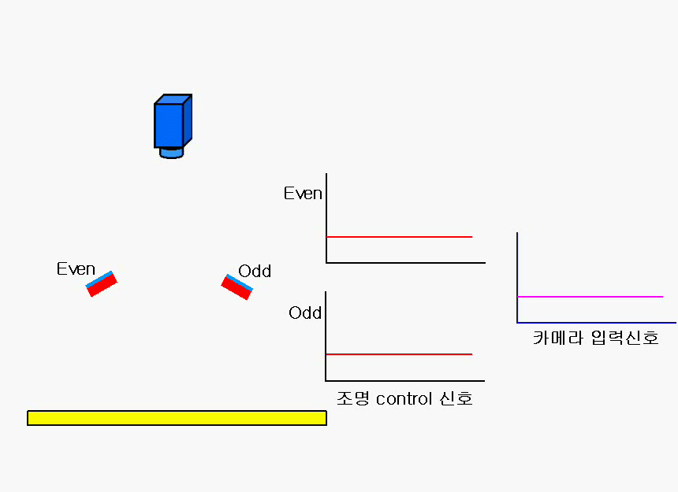
Optics in Surface Inspection
3.
Patent
Pending

Slide 14
Optics in Surface Inspection
Even 신호
Even + Odd 신호로 인한 카메라 신호
Odd 신호

Slide 15

Optics in Surface Inspection
Ex)
Even 신호
Odd 신호
Even 과 Odd의 세기를 달리하였을 때의 영상

Slide 16
Optics in Surface Inspection
3. Light Source
# Irradiation ways
1. Reflection Mode
# 교차 조명
# 직접 조명
# 경사 조명

Slide 17
Optics in Surface Inspection
3. Light Source
# Irradiation ways
2. Transmission Mode
# 직접 조명
# 확산 조명

Slide 18
Optics in Surface Inspection
3. Light Source
# Special Irradiation Systems
← Using Half Mirror
← Using Mirror
* Patent Pending

Slide 19
3. Light Source
Optics in Surface Inspection
# 반사체에 대한 빛의 세기
Intensity of Incident Beam
≃ Intensity of Reflection Beam
Intensity of Reflection Beam = 0
Intensity of Incident Beam
< Intensity of Reflection Beam
Intensity of Incident Beam
< Intensity of Reflection Beam

Slide 20
3. Light Source
Optics in Surface Inspection
# 투과체에 대한 빛의 세기
Intensity of
Transmittance Beam
=
>
>

Slide 21

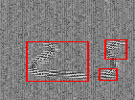



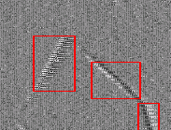
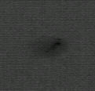
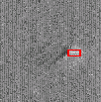
Optics in Surface Inspection
4. Relation between Light Source and Type of Defects
Ex) Images of Defects in the CCL (real Image ; processing image)
Pit and Dent Wrinkle
SCH CPS

Slide 22

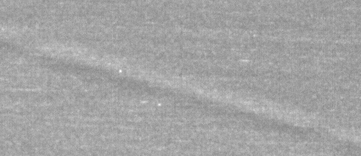
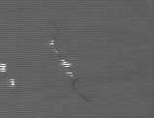

Optics in Surface Inspection
Ex) Images of Defects in the CCL
흑점 주름
P&D 버블

Slide 23
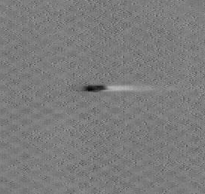
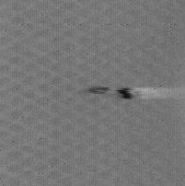
Optics in Surface Inspection
Ex) Images of Defects in the 부직포
이물

Slide 24


Optics in Surface Inspection
Ex) Images of Defects in the battery
눌림자국

Slide 25
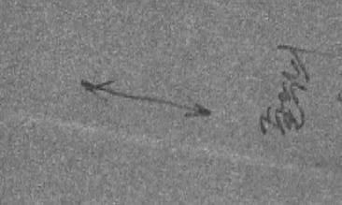
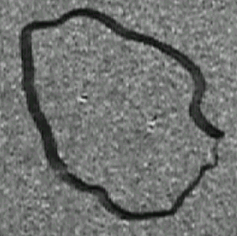
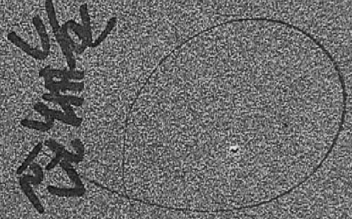
Optics in Surface Inspection
Ex) Images of Defects in the Diffuser film

Slide 26


Optics in Surface Inspection
Ex) Images of Defects in the ML film
PH,PHW (no filter)
PH,PHW (filter)

Slide 27






Optics in Surface Inspection
Ex) Images of Defects in the Transparent film (Real image)

Slide 28
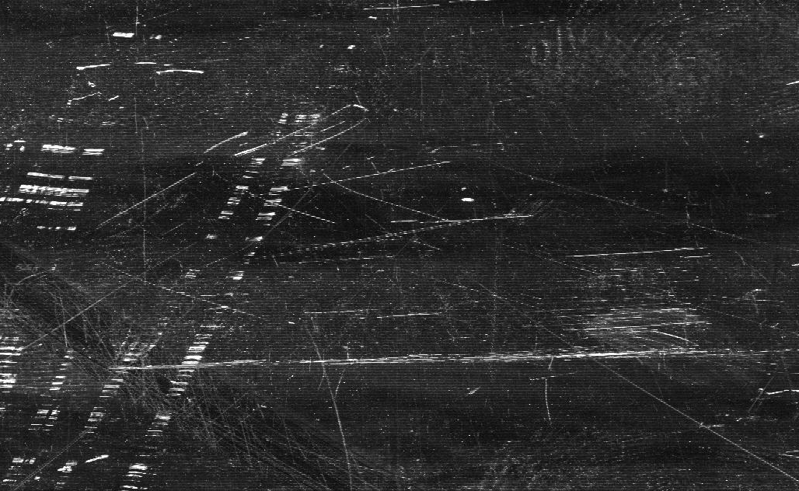
Optics in Surface Inspection
Ex) Images of Defects in the Object of High Reflectance (Real image)

Slide 29
Optics in Surface Inspection
5. Processing System
Even 조명
Odd 조명
A
B
A
B
각 부분을 High Pass
Filter를 적용한 후 미분
Filter를 적용시키면.
C
C
D
D

Slide 30
Optics in Surface Inspection
5. Processing System
A
( O, O )
B
( O, O )
C
( +, - )
D
( -, + )
Reference( ) 설정
Positive( ), Negative( )
Threshold 설정 – Single

Slide 31
Optics in Surface Inspection
5. Processing System
P3
P2
P1
N1
N2
N3
Multi Threshold 설정

Slide 32
Optics in Surface Inspection
5. Processing System
Filter
Threshold 설정

